Slide 1
Determining Cause and Effect from Observational Data: An Introduction to Causal Inference
Amy Nail, Ph.D.
Honestat Statistics & Analytics
amynail@honestat.com
Analytics>Forward
March 10, 2018
Notes:
Causal inference is a huge topic.
There are different people in different study areas writing different sets of papers using different jargon.
I cannot cover all of these, so my goals are
to give an introduction to people who may not be aware of this study area,
To show how to compare different methods/estimators—which means teaching how the discipline of statistics works
Show that some methods are better than others.

Slide 2
Example: Plantar fasciitis
Pain on the bottom of the foot and on the heel
Hurts when getting out of bed in the morning
Hurts when standing up after sitting for a while
Hurts a few hours after walking, running, hiking, rock climbing ☹
When severe, hurts during these activities ☹
The pain can keep you from participating in fun things ☹
Notes:
NOTE: I invented this example for illustrative purposes, and I made up all the numbers. (But I didn’t invent plantar fasciitis: it’s real.)

Slide 3
Goal: compare new treatment to old
Old treatment (control)
New treatment (treatment)
Stretching & strengthening exercises
Same as old, PLUS
Trigger-point dry-needling of calf muscles
Notes:
Even though both sets of people are getting some treatment, I may refer to the people getting the new treatment as the ones in the treatment group.

Slide 4
Response variable:
Change in range of motion (CROM) of ankle joint in dorsiflexion after 4 wks of treatment
CROM = 4wk ROM – baseline ROM
Bigger is better
Notes:
How to measure pain and progress toward recovery? We call this the response variable.
There are several ways to measure progress with a PF treatment (see https://www.ncbi.nlm.nih.gov/pmc/articles/PMC5038993/) . I’m choosing just one for this example.
I’m using the acronym CROM instead of using a delta because I use delta’s all over the rest of this presentation.
For these methods what type of response variables can be used?
Continuous
Dichotomous (read Lunceford & Davidian for more info)
What about time-to-event response variables?
Similar methods can be used, see extra slides at end.

Slide 5
Other variables that might affect recovery from PF
Gender
Age
Notes:
I’m only listing two variables to keep the example simple.
I’m pretty sure age affects PF recovery (from what I’ve read, and from first-hand experience).
Not sure about gender, but we’ll assume it has an effect for the sake of this example, because it allows us to do illustrative things later.
There are other things, like how long a person had symptoms before seeking treatment, but let’s keep the example simple.

Slide 6
Definition of confounding variable
Both must apply
The variable affects the response variable, AND
The variable is not balanced between treatment and control groups

Slide 7
Controlled experiment/ Randomized controlled trial (RCT) Could use Simple Random Sample (SRS)
100 subjects
50 old trt
50 new trt
Notes:
The assumption is that by randomly assigning subjects to treatments, the two treatment groups will be balanced over potential confounding variables such as gender, and age

Slide 8
If sample isn’t balanced over confounders, could use Stratified Random Sample
100 subjects
30 male
15 old trt
15 new trt
70 female
35 old trt
35 new trt
Notes:
If we knew our set of volunteers was imbalanced over gender, we would use a stratified random sample to ensure gender balance in the treatment groups.

Slide 9
Instead of RCT, use historical controls (observational data)
Dr. Jones has a database of 50 patients treated with the old treatment
Use those patients as controls
Give new treatment to next 50 patients
Use them as treatment group
Notes:
Note:
You would probably not use historical controls for a plantar fasciitis study, because plantar fasciitis is not rare—there should be plenty of potential patients to use in a trial.
But historical controls ARE used for rare diseases. They are used to establish whether or not there are statistically significant treatment effects, and these studies are used in the application to the FDA to justify the efficacy of drugs/treatments, and there are plenty of drugs/treatments that the FDA has approved on the strength of such analyses. (Including my client’s drug/treatment!)

Slide 10
Groups may not be balanced
(Historical) Control group
Treatment group
15 male
35 female
Average age: 32 years
28 male
22 female
Average age: 25 years
How can we use probability theory to create balance?

Slide 11
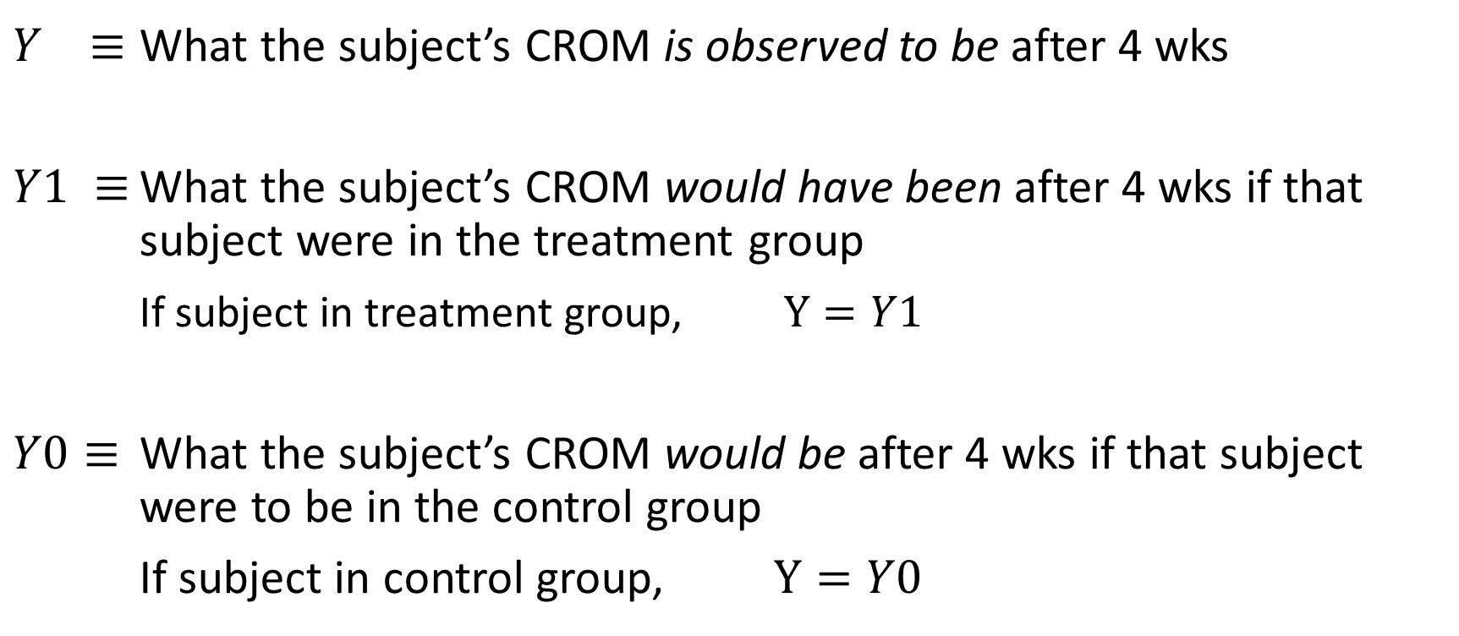
Counterfactual framework
$Y ≡$ What the subject’s CROM is observed to be after 4 wks
$Y1 ≡$ What the subject’s CROM would have been after 4 wks if that subject were in the treatment group
If subject in treatment group, $Y=Y1$
$Y0≡$ What the subject’s CROM would be after 4 wks if that subject were to be in the control group
If subject in control group, $Y=Y0$
Notes:
The three bars instead of the two bar equal sign indicates that this is the definition of the notation. An equals symbol has slightly different meaning than the “is defined as” symbol.
(In other contexts, the three bar symbol means “is equivalent to”. For it to have that meaning, the thing on the left and the thing on the right must both be complete (mathematical) sentences.)

Slide 12
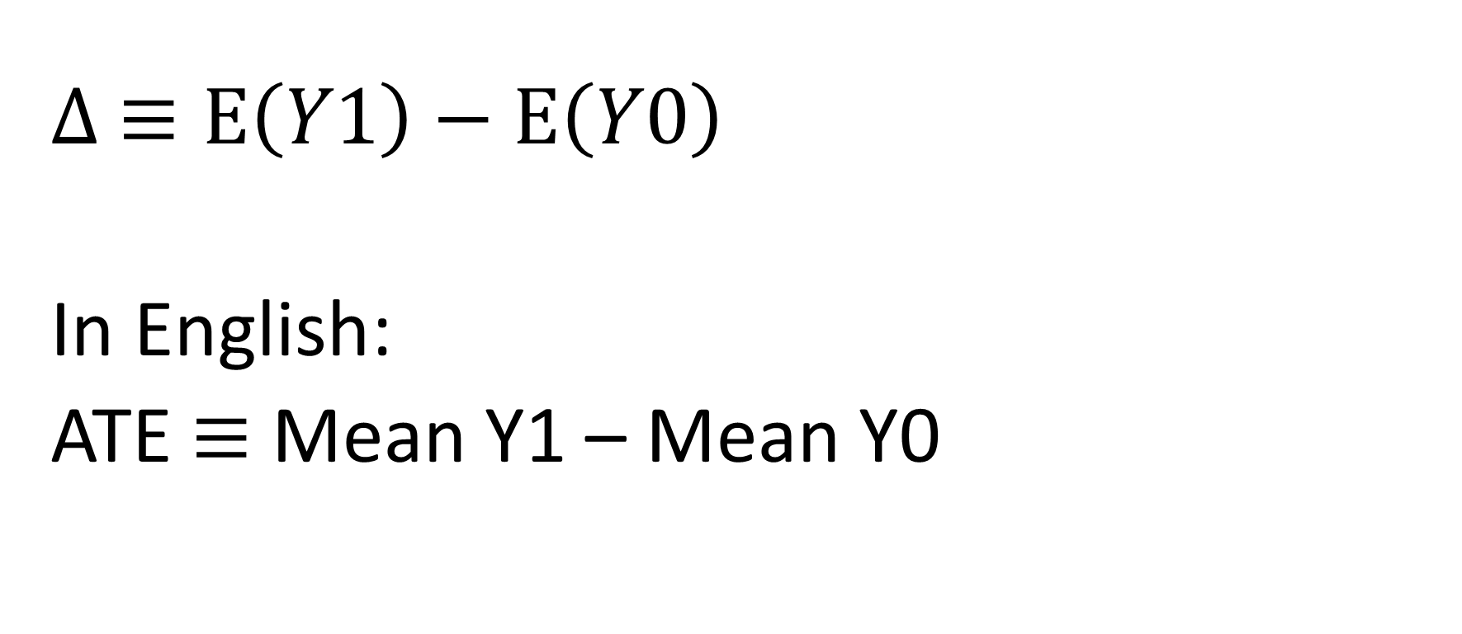
Definition: Average Treatment Effect (ATE)
$∆ ≡E\left(Y1\right)−$ $E\left(Y0\right)$
In English:
ATE $≡$ Mean Y1 – Mean Y0
Notes:
Here, we are defining the TRUE underlying quantity that we are interested in, the average treatment effect (ATE).
We will use the symbol Delta for the ATE, because it is a difference.
E(Y1) is the expected value of Y1. This is the probability-weighted average of Y1—the ROM if the person was in the treatment group--over all people in the population of interest.
E(Y0) is the expected value of Y0—this is the probability-weighted average of Y0—the ROM if the person was in the control group--over all people in the population of interest.
The difference is the ATE, and that’s what we want to know.
More specifically, we want to know if Delta is different from 0.
This is a theoretical quantity. It is impossible to observe this quantity.
Therefore, we’ll discuss estimators of this quantity.
Estimators are formulas used to get estimates. The estimator is the formula, and the actual number we get—like 4, for example—is the estimate.

Slide 13
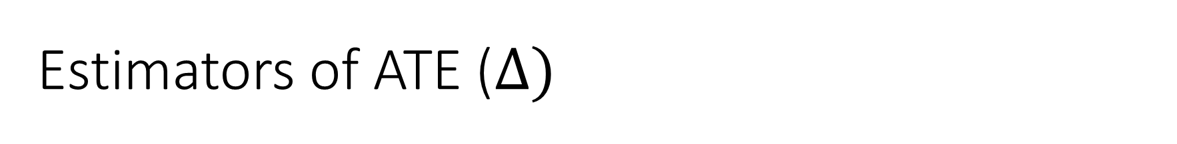
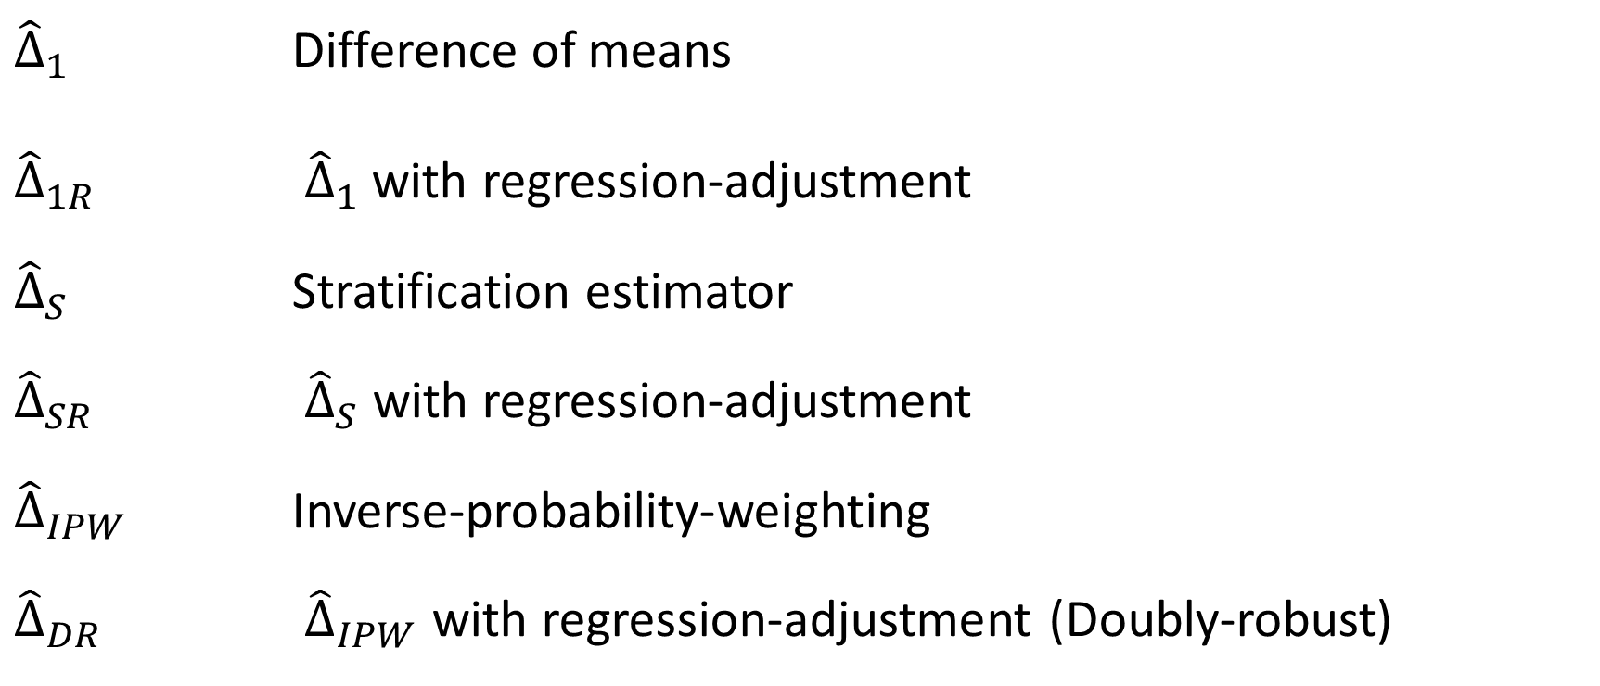
Estimators of ATE ($∆)$
${\hat{∆}}_{1}$ Difference of means
${\hat{∆}}_{1R}$ ${\hat{∆}}_{1}$with regression-adjustment
${\hat{∆}}_{S}$ Stratification estimator
${\hat{∆}}_{SR}$ ${\hat{∆}}_{S}$ with regression-adjustment
${\hat{∆}}_{IPW}$ Inverse-probability-weighting
${\hat{∆}}_{DR}$ ${\hat{∆}}_{IPW}$ with regression-adjustment (Doubly-robust)
Notes:
Estimators are formulas used to get estimates. The estimator is the formula, the estimate is the number you get when you use the formula, like 4 or 37.2, or 0.003.
These are the estimators of ATE that I’ll discuss and compare in this talk. There are others. I chose to discuss this set of estimators for two reasons.
First, because there is a landmark paper, Lunceford and Davidian 2004, that compares these head-to-head in terms of bias and precision (accuracy) using theoretical results backed up by a simulation study. This paper is amazing.
Second, discussing the progression of these methods provides valuable intuition into why they work.
One set of methods not explicitly discussed in this talk are matching methods—which can be implemented using GREEDY and OPTIMAL matching. Matching methods can be based on using distance metrics for X, or based on propensity scores. There are many places you can get R or SAS code (Python, too, probably) to implement these methods. They are a variation on the Stratification methods given in this talk. I do not recommend them because they lack regression-adjustment. For my clients, I used the 1R, 1R with common support, SR (with common support), and DR (with common support) estimators.
See the main list of references at the end to learn what I mean when I say “common support”.

Slide 14
Things we need for each estimator
Formula or method to calculate estimate
Formula or method to get confidence intervals (CI)
Notes:
We always want to quantify uncertainty.
If the 95% CI contains 0, we’ll say there is no statistically significant ATE.
Otherwise, we’ll say there is.

Slide 15
How to compare estimators
Want to minimize bias
Want to minimize variance of estimator
(e.g., width of CI)
Want a 95% CI to have 95% coverage probability
Notes:
On whiteboard—bulls eye picture
If bias is bad enough, we might not care about 2 and 3 at all.
In this talk, I’ll have time to discuss bias. I may not discuss variance and coverage probability thoroughly, but they are important. You can read Lunceford and Davidian for those results, but since it is very difficult to read, you can also get in touch with someone like me for help summarizing them and deciding on your course of action (one of many shameless plugs for my consulting services ☺).

Slide 16
Why I chose these estimators
There is a head-to-head comparison of these in Lunceford & Davidian 2004
Extensive section with theoretical results
Extensive simulation study to back up the theory
Notes:
Lunceford & Davidian 2004 don’t consider Delta1 (I do to help with the progression of methods explanation), and their name for Delta1R is DeltaML.

Slide 17
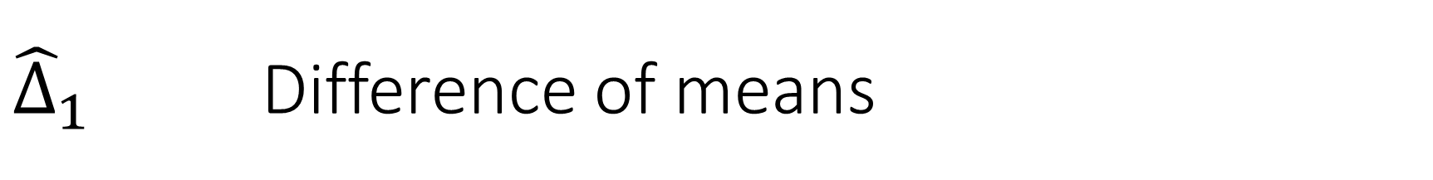

${\hat{∆}}_{1}$ Difference of means
$${\hat{∆}}_{1} ≡ \frac{1}{50}\sum_{\begin{aligned}trt \\ group\end{aligned}}{Y_{i}} − \frac{1}{50}\sum_{\begin{aligned}ctrl \\ group\end{aligned}}{Y_{i}}$$
Notes:
This is obviously a bad idea, because men and women are not evenly distributed over the two groups, and the treatment group has a lower average age.

Slide 18
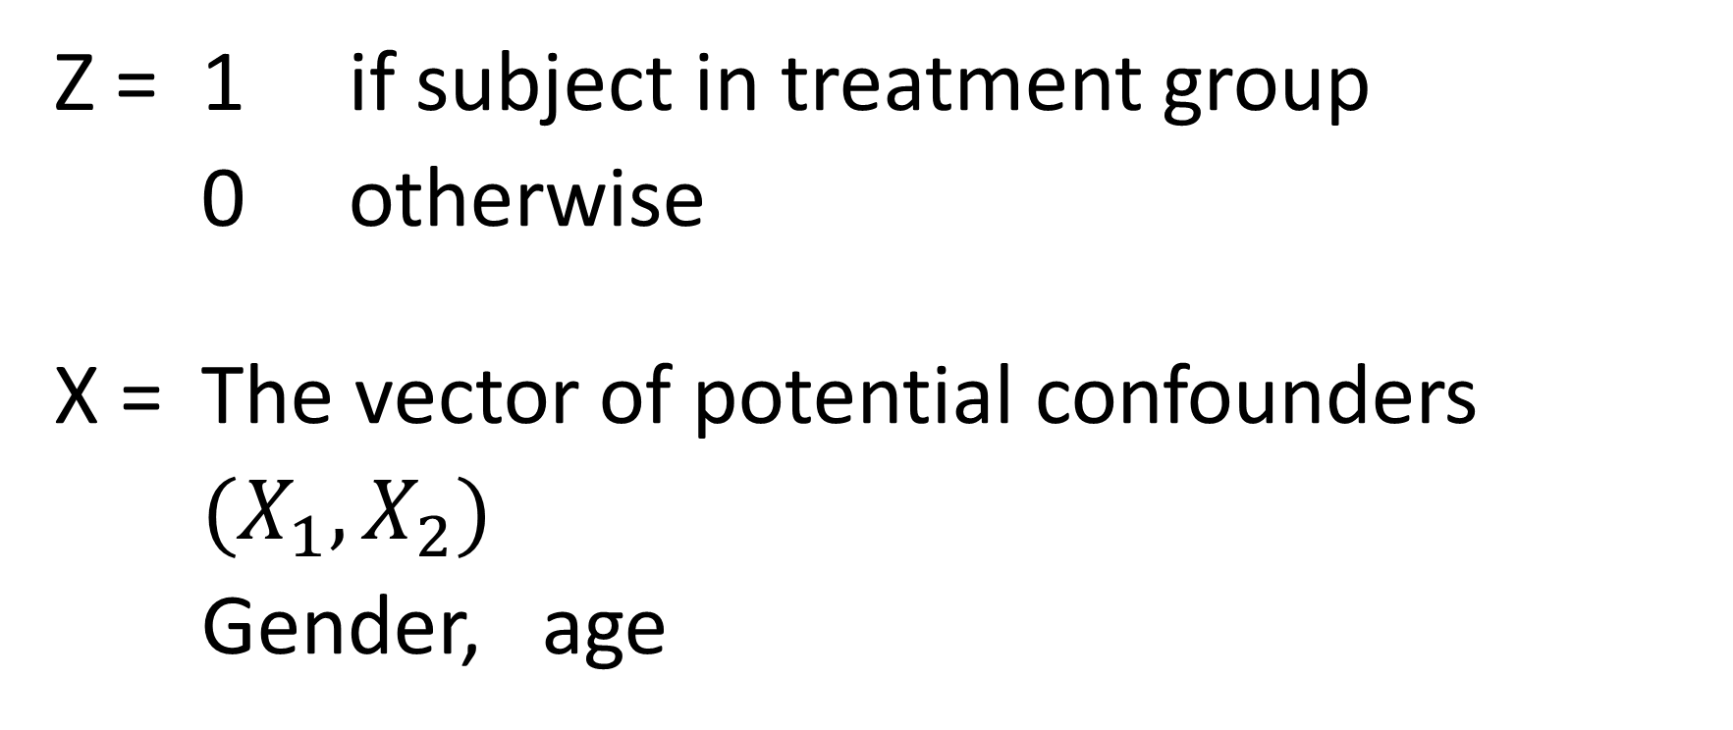
More notation
Z = 1 if subject in treatment group
0 otherwise
X = The vector of potential confounders
$(X_{1}, X_{2})$
Gender, age
Notes:
Z is an indicator variable that tells us whether a subject was treated or not.
X is one symbol that represents two variables. To discuss the probability theory, we don’t need to d=use separate symbols such as X1, X2. for the three confounders.

Slide 19


Another way to calculate ${\hat{∆}}_{1}$
Notice if we fit the model
$Y= β_{0}+$ $β_{Z}Z$
Then
${\hat{∆}}_{1}=$ $\hat{β_{Z}}$
Notes:
Trust me on this. It’s because Z is an indicator variable.

Slide 20
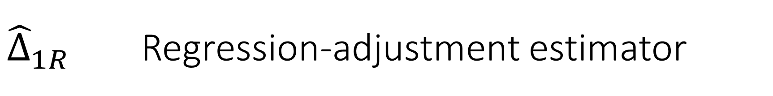

${\hat{∆}}_{1R}$ Regression-adjustment estimator
Fit the model
$Y= β_{0}+$ $β_{Z}Z +$ ${ β}_{1}X_{1}$ + $β_{2}X_{2}$
Use
${\hat{∆}}_{1R}≡$ $\hat{β_{Z}}$
Notes:
Remember Y is Change in Range of Motion
The idea here is to just use regression to account for the effects of confounding covariates.
This estimator is known to have high bias.
This regression model assumes that it is appropriate to model age as a linear effect. It is not generally OK to make such an assumption without a reason (a graph of CROM vs. age) to do so, but I’m trying to keep the model simple.

Slide 21
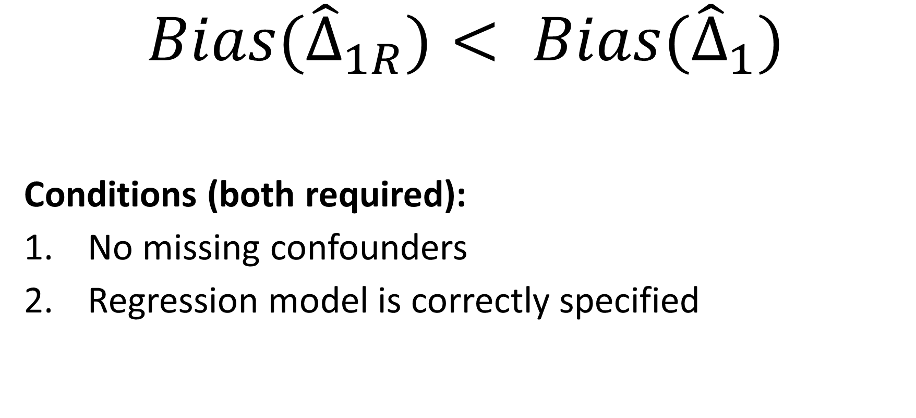
What we know so far
$${Bias(\hat{∆}}_{1R})< {Bias(\hat{∆}}_{1})$$
Conditions (both required):
No missing confounders
Regression model is correctly specified

Slide 22
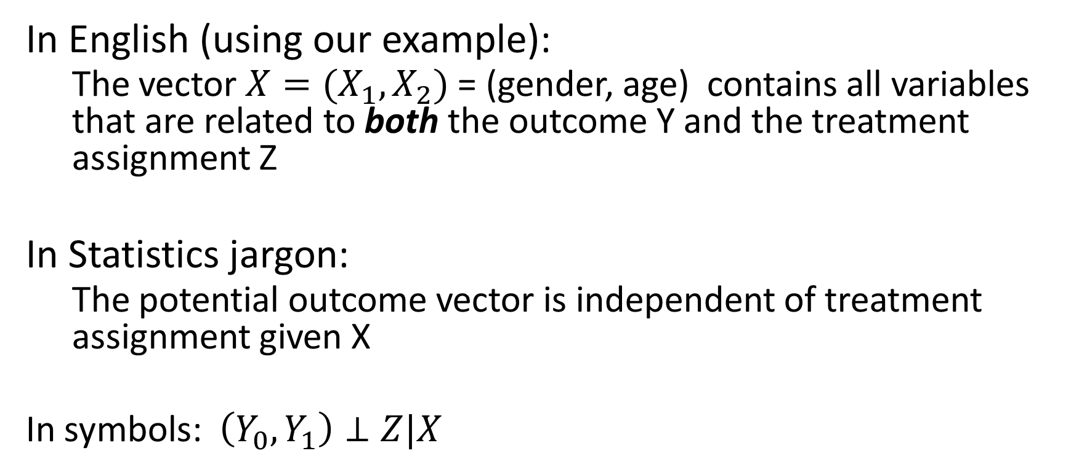
Assumption of no missing confounders
In English (using our example):
The vector $X=(X_{1}, X_{2})$ = (gender, age) contains all variables that are related to both the outcome Y and the treatment assignment Z
In Statistics jargon:
The potential outcome vector is independent of treatment assignment given X
In symbols: $\left(Y_{0},Y_{1}\right)⊥Z|X$
Notes:
For all of the following estimators, the following assumption is required.
This is an assumption you must be able to justify making in order to use these methods.
It was originally called the assumption of strongly ignorable treatment assignment (you can see why it was renamed!)

Slide 23
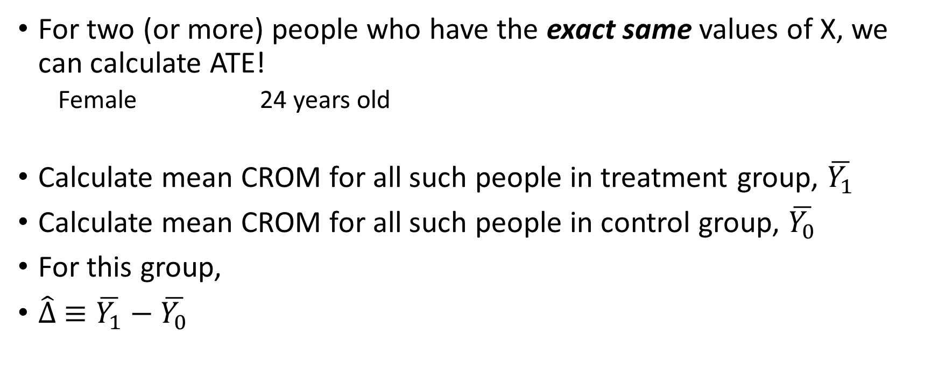
Why is this assumption important?
For two (or more) people who have the exact same values of X, we can calculate ATE!
Female 24 years old
Calculate mean CROM for all such people in treatment group, $\overline{Y_{1}}$
Calculate mean CROM for all such people in control group, $\overline{Y_{0}}$
For this group,
$\hat{∆} ≡\overline{Y_{1}}−\overline{Y_{0}}$

Slide 24
Problem
We will not get exact matches
Solution
Use groups that are close to being alike
Use multi-dimensional distance metrics to create groups

Slide 25
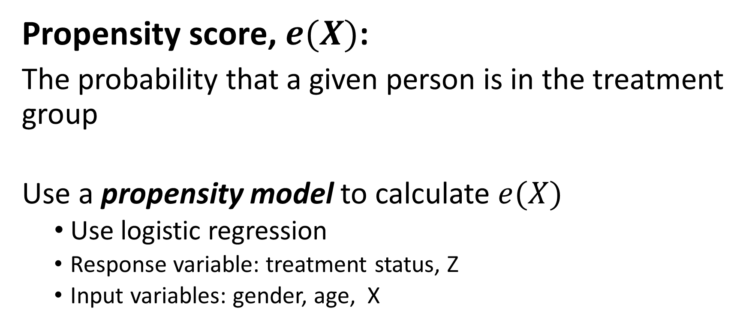
Even better solution—introducing the…
Propensity score, $e(X)$:
The probability that a given person is in the treatment group
Use a propensity model to calculate $e(X)$
Use logistic regression
Response variable: treatment status, Z
Input variables: gender, age, X
Notes:
Why am I using e(X)?
I’m following the notation in Lunceford & Davidian 2004. Did I mention you should read that?
I’m not writing out the logistic regression model because I don’t think it’s all that helpful if you don’t already know it, and if you do already know it, you don’t need me to write it out.

Slide 26
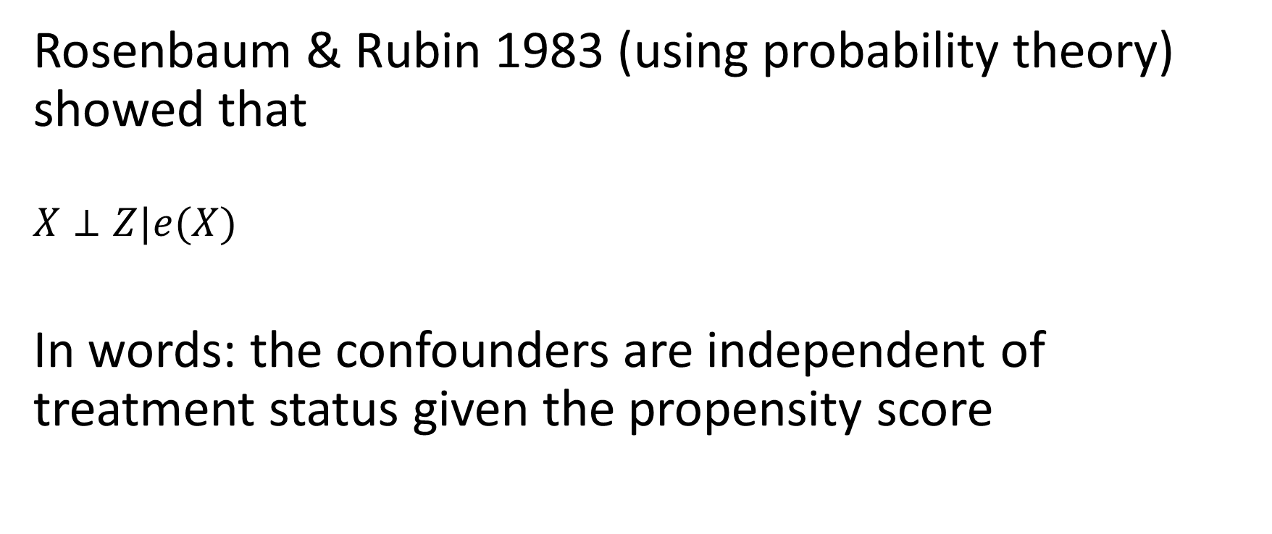
Powerful result (for statisticians)
Rosenbaum & Rubin 1983 (using probability theory) showed that
$$X⊥Z|e(X)$$
In words: the confounders are independent of treatment status given the propensity score

Slide 27
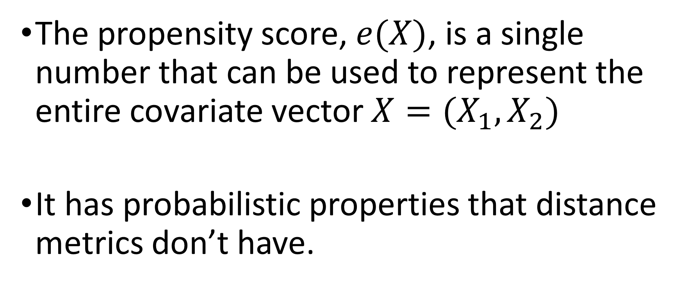
What does that mean?!
The propensity score, $e(X)$, is a single number that can be used to represent the entire covariate vector $X=(X_{1},X_{2})$
It has probabilistic properties that distance metrics don’t have.
Notes:
Because it’s also a probability!

Slide 28
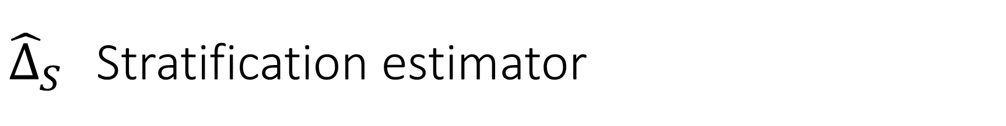
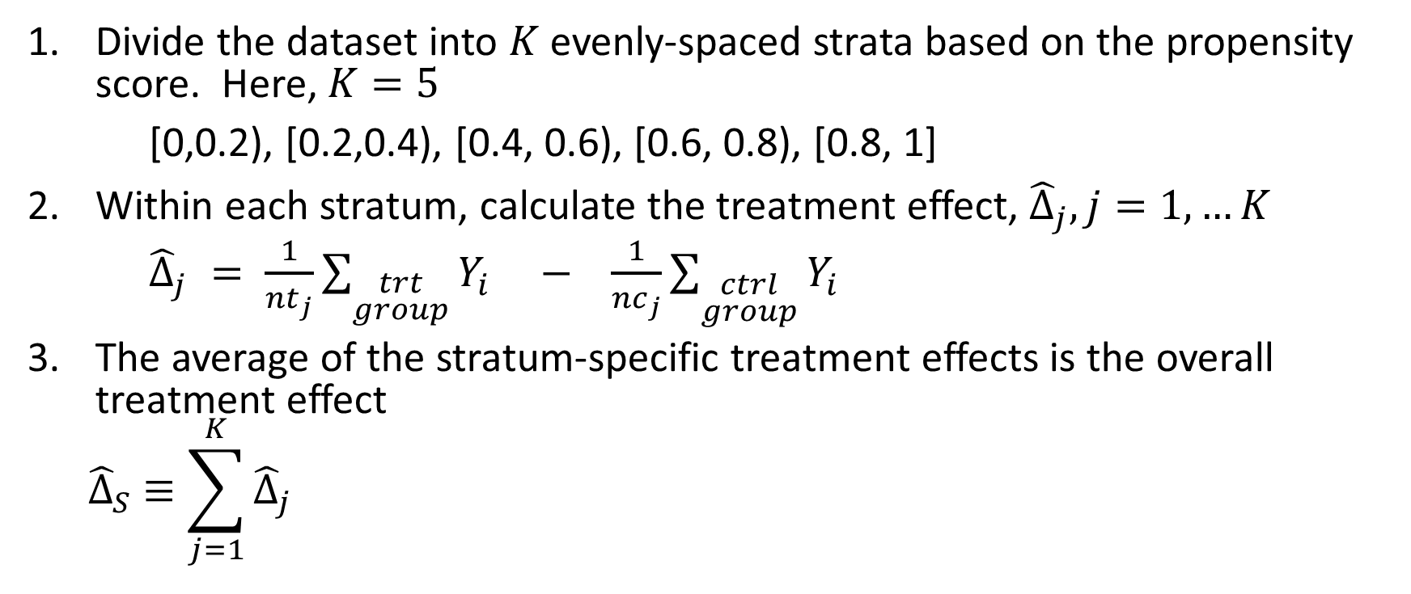
${\hat{∆}}_{S}$ Stratification estimator
Divide the dataset into $K$evenly-spaced strata based on the propensity score. Here, $K=5$
[0,0.2), [0.2,0.4), [0.4, 0.6), [0.6, 0.8), [0.8, 1]
Within each stratum, calculate the treatment effect, ${\hat{Δ}}_{j}, j=1, …K$
${\hat{Δ}}_{j} = \frac{1}{{nt}_{j}}\sum_{\begin{aligned}trt \\ group\end{aligned}}{Y_{i}} − \frac{1}{{nc}_{j}}\sum_{\begin{aligned}ctrl \\ group\end{aligned}}{Y_{i}}$
The average of the stratum-specific treatment effects is the overall treatment effect
$${\hat{∆}}_{S} ≡\sum_{j=1}^{K}{{\hat{Δ}}_{j}}$$
Notes:
Using the propensity score kind of like a distance metric

Slide 29
Problem with stratification estimator
The strata can be too large, and the degree of homogeneity may be low within a stratum.
Solution
Do regression adjustment within each stratum
Notes:
Regression-adjustment makes everything better!

Slide 30
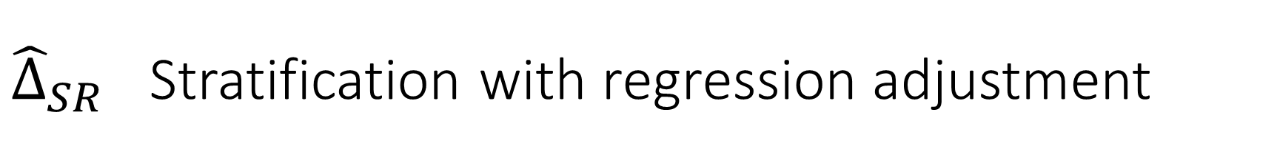
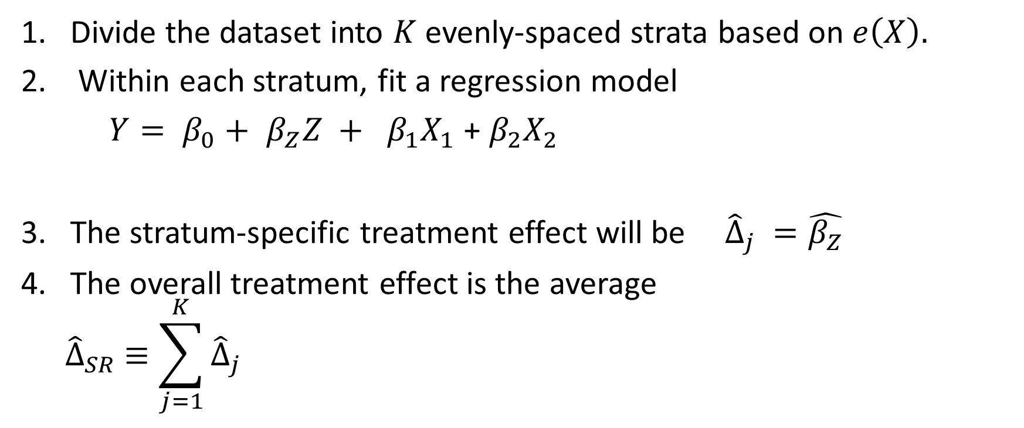
${\hat{∆}}_{SR}$ Stratification with regression adjustment
Divide the dataset into $K$evenly-spaced strata based on $e\left(X\right).$
Within each stratum, fit a regression model
$Y= β_{0}+$ $β_{Z}Z +$ ${ β}_{1}X_{1}$ + $β_{2}X_{2}$
The stratum-specific treatment effect will be ${\hat{Δ}}_{j} =\hat{β_{Z}}$
The overall treatment effect is the average
$${\hat{∆}}_{SR} ≡\sum_{j=1}^{K}{{\hat{Δ}}_{j}}$$
Notes:
Using the propensity score kind of like a distance metric

Slide 31
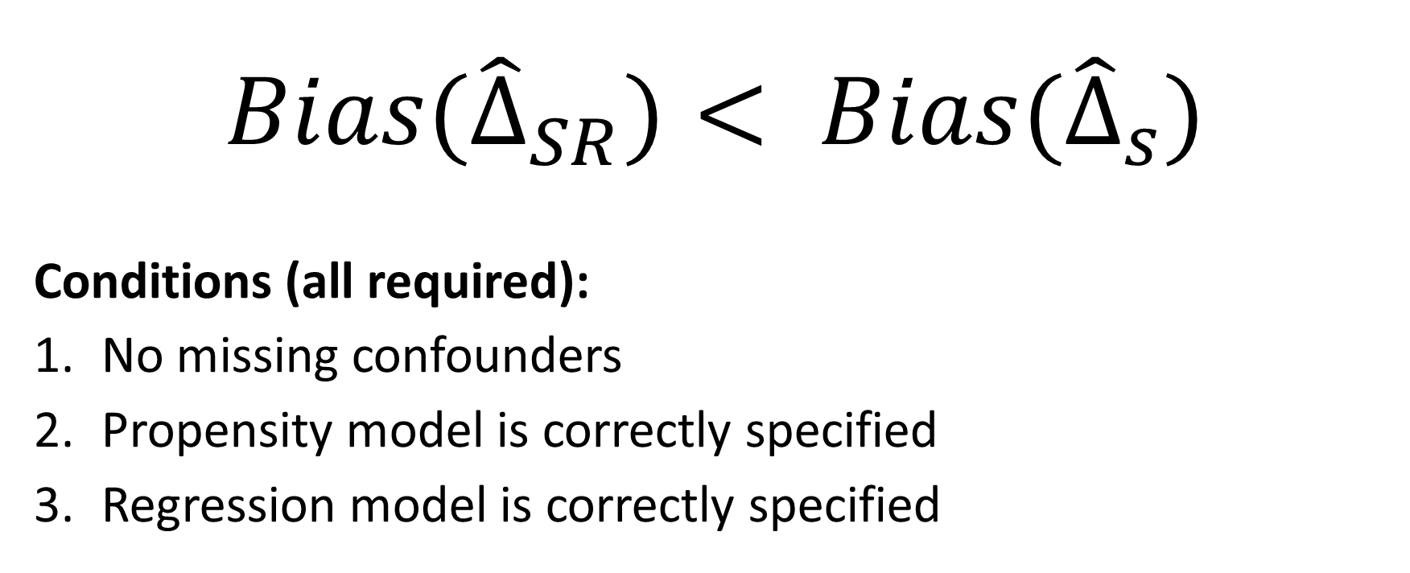
What we know so far
$${Bias(\hat{∆}}_{SR})< {Bias(\hat{∆}}_{s})$$
Conditions (all required):
No missing confounders
Propensity model is correctly specified
Regression model is correctly specified

Slide 32
Done with
Stratification estimators
Move on to
Weighting estimators

Slide 33

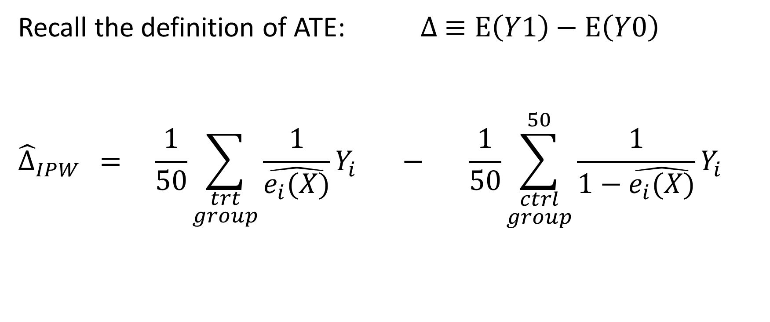
${\hat{∆}}_{IPW}$ Inverse-probability-weighting
Recall the definition of ATE: $∆ ≡E\left(Y1\right)−$ $E\left(Y0\right)$
$${\hat{∆}}_{IPW} = \frac{1}{50}\sum_{\begin{aligned}trt \\ group\end{aligned}}{\frac{1}{\hat{e_{i}(X)}}Y_{i}} − \frac{1}{50}\sum_{\begin{aligned}ctrl \\ group\end{aligned}}^{50}{\frac{1}{1−\hat{e_{i}(X)}}Y_{i}}$$
Notes:
Putting a hat on top of the E means we’re talking about the estimate of E.
E(Y1) = the expected value of Y1, which you can think of as a mean if you’re not familiar with the definition of expected value. It’s actually a probability-weighted average.
ehat(X) is the probability that a person with covariate vector X is in the treatment group
1-ehat(X) is the probability that a person with covariate vector X is in the control group

Slide 34
Why does IPW make sense? Simpler example.
 | Total | Treatment | Control
Male | 10 | 6 | 4
Female | 20 | 5 | 15
Notes:
Suppose gender is our only confounding variable.
Suppose there are 10 male and 20 female subjects.

Slide 35
Why does IPW make sense? Simple example.
 | Total | Treatment | Control
Male | 10 | 6 | 4
Female | 20 | 5 | 15
$$\hat{e}(male) =\frac{6}{10}$$
Notes:
The probability of being treated for X=male is 6/10.

Slide 36
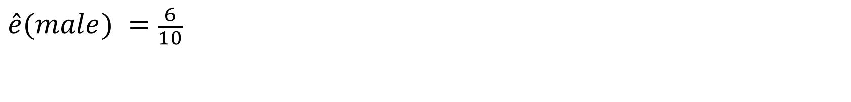
Why does IPW make sense? Simple example.
 | Total | Treatment | Control
Male | 10 | 6 * 10/6 = 10 | 4
Female | 20 | 5 | 15
$$\hat{e}(male) =\frac{6}{10}$$
Notes:
The inverse of 6/10 is 10/6, and that’s the weight we apply to the Y-values (the CROMs) of each of the 6 men in the treatment group.
This effectively changes the treatment group to one that has 10 men in it.

Slide 37
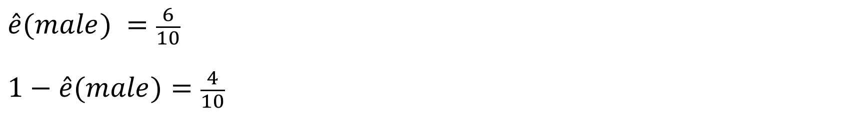
Why does IPW make sense? Simple example.
 | Total | Treatment | Control
Male | 10 | 6 * 10/6 = 10 | 4
Female | 20 | 5 | 15
$$\hat{e}(male) =\frac{6}{10}$$
$$1−\hat{e}(male)=\frac{4}{10}$$
Notes:
The probability of being in the control group if X=male is 4/10

Slide 38
Why does IPW make sense? Simple example.
 | Total | Treatment | Control
Male | 10 | 6 * 10/6 = 10 | 4 * 10/4 = 10
Female | 20 | 5 | 15
$$\hat{e}(male) =\frac{6}{10}$$
$$1−\hat{e}(male)=\frac{4}{10}$$
Notes:
The inverse of 4/10 is 10/4. We apply a weight of 10/4 to each man in the control group, and that effectively creates a control group that has 10 men in it.
So the number of men is now equal in the treatment and control groups.

Slide 39
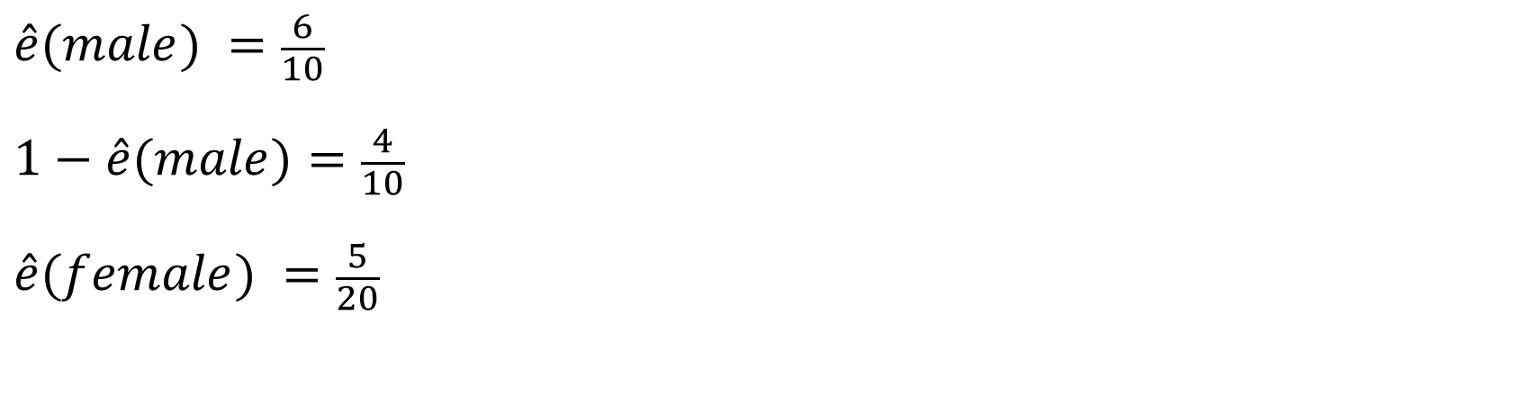
Why does IPW make sense? Simple example.
 | Total | Treatment | Control
Male | 10 | 6 * 10/6 = 10 | 4 * 10/4 = 10
Female | 20 | 5 | 15
$$\hat{e}(male) =\frac{6}{10}$$
$$1−\hat{e}(male)=\frac{4}{10}$$
$$\hat{e}(female) =\frac{5}{20}$$
Notes:
The probability of being in the treatment group if X=female is 5/20.

Slide 40
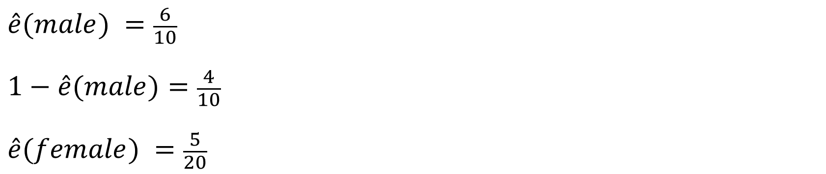
Why does IPW make sense? Simple example.
 | Total | Treatment | Control
Male | 10 | 6 * 10/6 = 10 | 4 * 10/4 = 10
Female | 20 | 5 * 20/5 = 20 | 15
$$\hat{e}(male) =\frac{6}{10}$$
$$1−\hat{e}(male)=\frac{4}{10}$$
$$\hat{e}(female) =\frac{5}{20}$$
Notes:
The inverse of 5/20 is 20/5, so we apply this weight to each of the women in the treatment group, effectively creating a treatment group that has 20 women init.

Slide 41
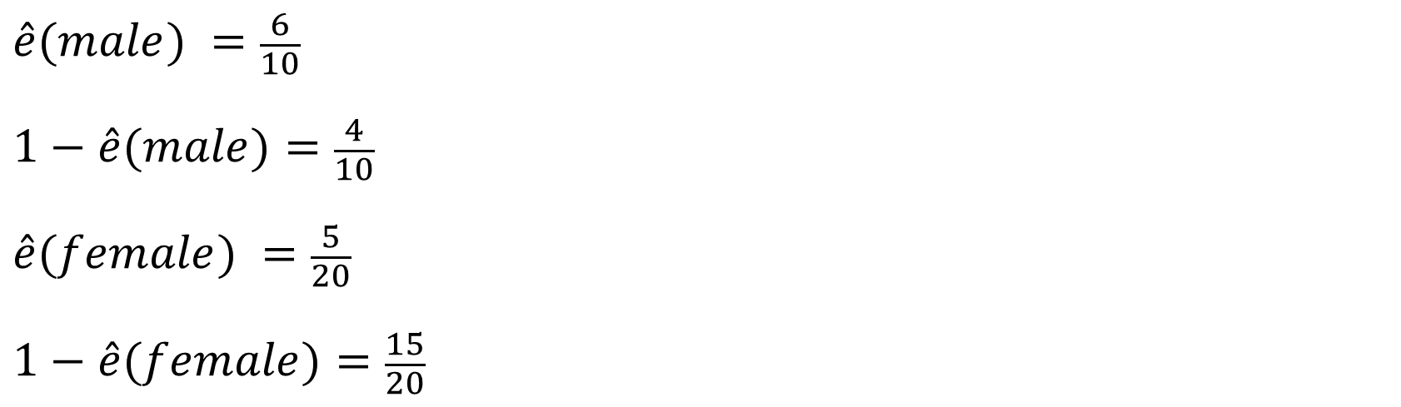
Why does IPW make sense? Simple example.
 | Total | Treatment | Control
Male | 10 | 6 * 10/6 = 10 | 4 * 10/4 = 10
Female | 20 | 5 * 20/5 = 20 | 15
$$\hat{e}(male) =\frac{6}{10}$$
$$1−\hat{e}(male)=\frac{4}{10}$$
$$\hat{e}(female) =\frac{5}{20}$$
$$1−\hat{e}(female)=\frac{15}{20}$$
Notes:
The probability of being in the control group if X=female is 15/20.

Slide 42
Why does IPW make sense? Simple example.
 | Total | Treatment | Control
Male | 10 | 6 * 10/6 = 10 | 4 * 10/4 = 10
Female | 20 | 5 * 20/5 = 20 | 15 * 20/15 = 20
$$\hat{e}(male) =\frac{6}{10}$$
$$1−\hat{e}(male)=\frac{4}{10}$$
$$\hat{e}(female) =\frac{5}{20}$$
$$1−\hat{e}(female)=\frac{15}{20}$$

Slide 43

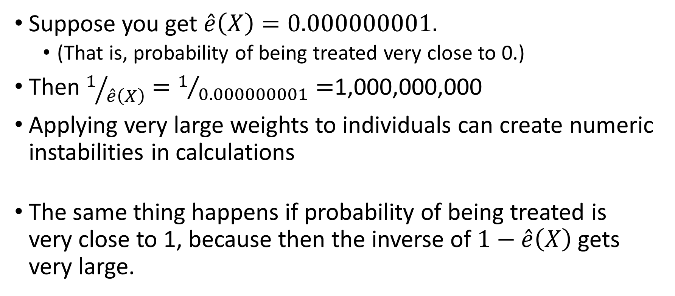
${\hat{∆}}_{IPW}$ has some problems, however
Suppose you get $\hat{e}\left(X\right)=0.000000001.$
(That is, probability of being treated very close to 0.)
Then $1/{\hat{e}\left(X\right)}=1/{0.000000001}=$1,000,000,000
Applying very large weights to individuals can create numeric instabilities in calculations
The same thing happens if probability of being treated is very close to 1, because then the inverse of $1−\hat{e}\left(X\right)$ gets very large.
Notes:
One solution to this problem is to use trimming methods, but I’m not covering those methods in this talk. (No time!)

Slide 44

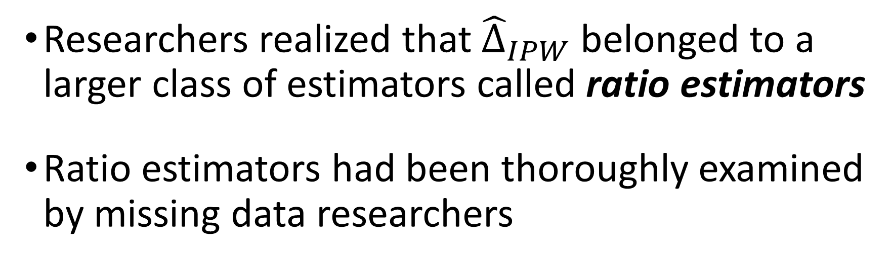
Progression from ${\hat{∆}}_{IPW}$ to ${\hat{∆}}_{DR}$ (IPW with regression-adjustment)
Researchers realized that ${\hat{∆}}_{IPW}$ belonged to a larger class of estimators called ratio estimators
Ratio estimators had been thoroughly examined by missing data researchers
Notes:
Even better solution to IPW problems.

Slide 45
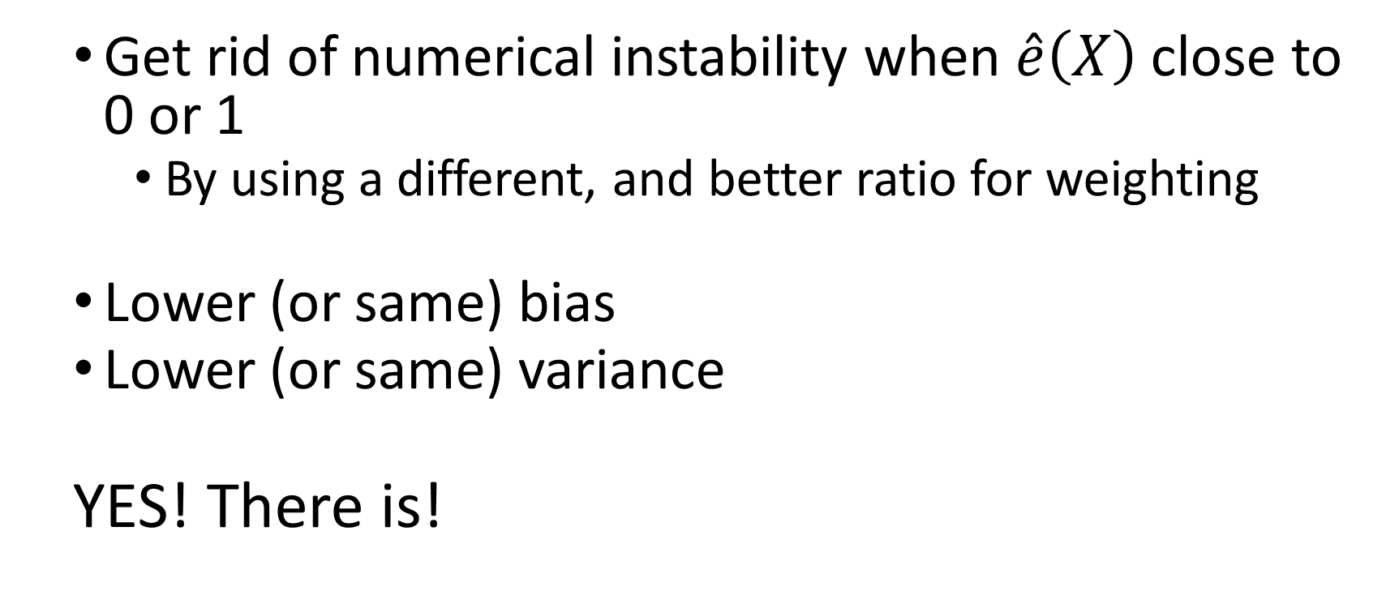
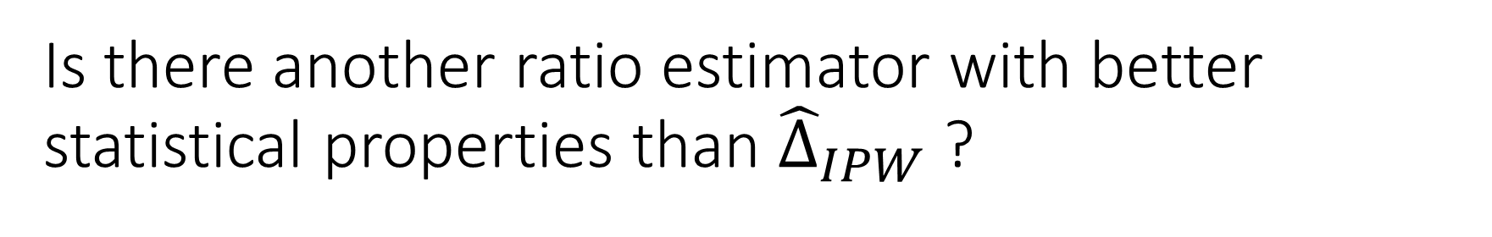
Is there another ratio estimator with better statistical properties than ${\hat{∆}}_{IPW}$ ?
Get rid of numerical instability when $\hat{e}\left(X\right)$ close to 0 or 1
By using a different, and better ratio for weighting
Lower (or same) bias
Lower (or same) variance
YES! There is!

Slide 46
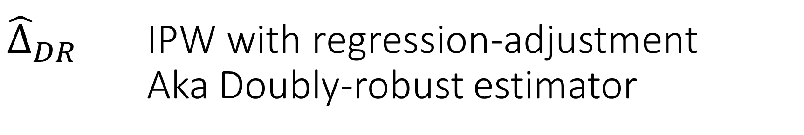

${\hat{∆}}_{DR}$ IPW with regression-adjustment Aka Doubly-robust estimator
$${\hat{∆}}_{DR}=$$
$$\frac{1}{50}\sum_{\begin{aligned}trt \\ group\end{aligned}}{\frac{Y_{i}−\left(Z_{i}−{\hat{e}}_{i}\right)m_{1i}}{{\hat{e}}_{i}}}−\frac{1}{50}\sum_{\begin{aligned}ctrl \\ group\end{aligned}}{\frac{Y_{i}+(Z_{i}−{\hat{e}}_{i})m_{0i}}{1−{\hat{e}}_{i}}}$$
Notes:
I don’t have time to explain this estimator as thoroughly as I explained the others.
In each term, you see the IPW estimator is there, plus additional terms in the numerator have been added.
These additional terms involve fitting two regression models. M1 represents the predicted value from a regression model fit to the treatment group, and m0 represents the predicted value from a regression model fit to the control group. Lunceford & Davidian 2004 has more explanation, but since L&D2004 is hard to read, you could always hire a statistical consultant to explain it and perhaps write a statistical analysis plan your team can use.

Slide 47

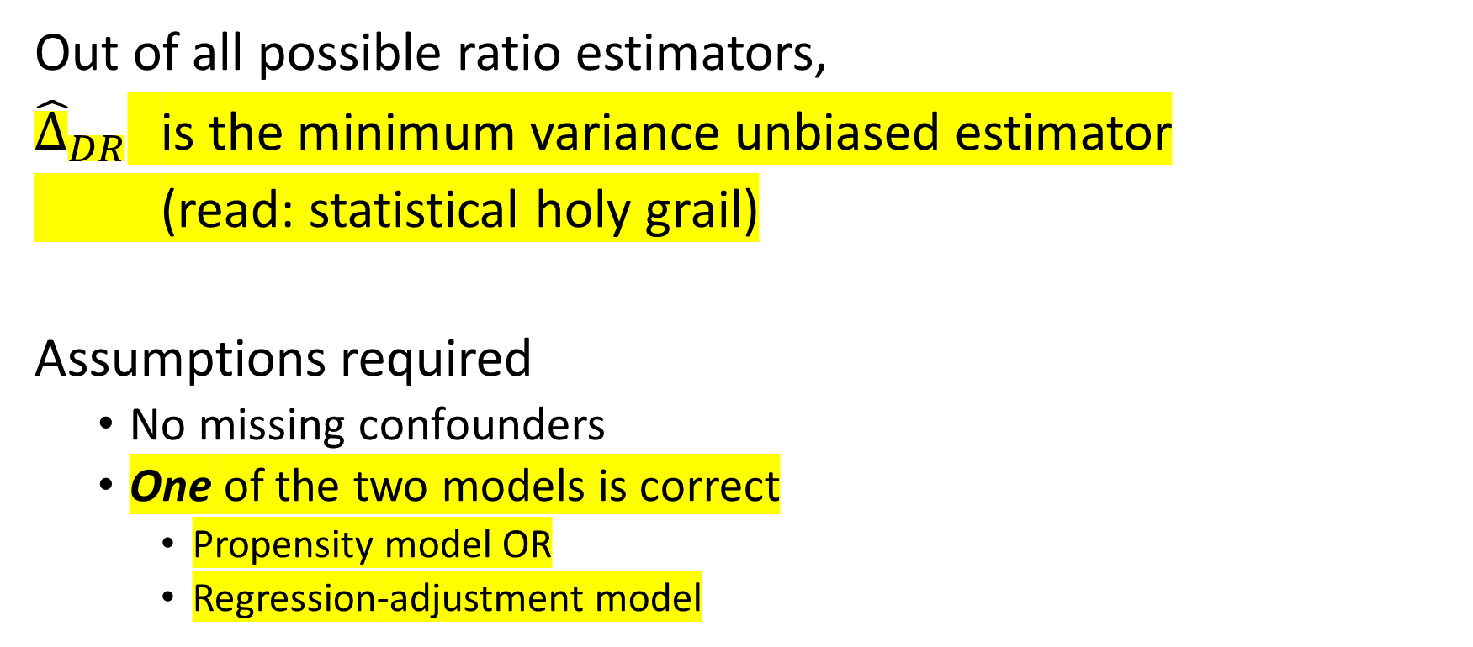
Remarkable properties of ${\hat{∆}}_{DR}$
Out of all possible ratio estimators,
${\hat{∆}}_{DR}$ is the minimum variance unbiased estimator
(read: statistical holy grail)
Assumptions required
No missing confounders
One of the two models is correct
Propensity model OR
Regression-adjustment model
Notes:
This is why it’s called Doubly Robust. If we got one of the models wrong, it’s still the MVUE. Wow.
In my experience, we could use certain variables in the propensity model that we could not use in the regression-adjustment model.

Slide 48
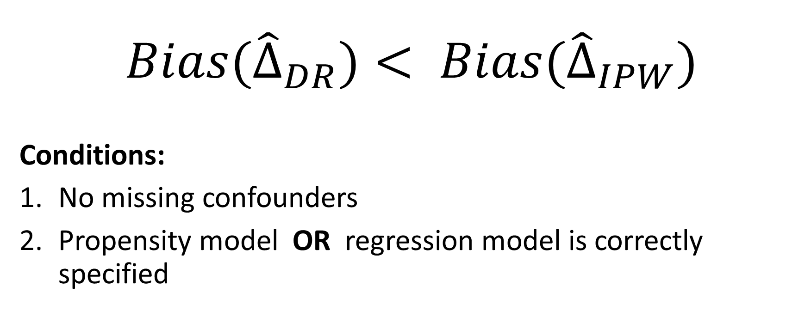
What we know
$${Bias(\hat{∆}}_{DR})< {Bias(\hat{∆}}_{IPW})$$
Conditions:
No missing confounders
Propensity model OR regression model is correctly specified

Slide 49
More comparisons are made in Lunceford & Davidian 2004
When all assumptions are satisfied, comparing between all 3 groups
When propensity model is not correctly specified (in different ways)
When regression model is not correctly specified (in different ways)
When extra variables are added
Other comparisons elsewhere:
What if both models are not correctly specified?
Hope you learned from what we had time for!
Notes:
There’s much more to say than I had time to cover, but I hope your appetite to learn about causal inference has been whetted!

Slide 50
References
Lunceford, Jared K.; Davidian, Marie. 2004 “Stratification and weighting via the propensity score in estimation of causal treatment effects: a comparative study.” Statistics in Medicine 23(19): 2937-2960.
Luo, Zhehui; Gardiner, Joseph C.; Bradley, Cathy J. 2010 “Applying propensity score methods in medical research: Pitfalls and prospects.” Medical Care Research and Review 67(5): 528-554. Doi: 10.1177/1077558710361486.
Stuart, Elizabeth A. 2010 “Matching methods for causal inference: A review and a look forward.” Statistical Science 25(1): 1-21. Doi: 10.1214/09-STS313.

Slide 51
Thank you
Amy Nail, Ph.D.
Honestat Statistics & Analytics
amynail@honestat.com

Slide 52
Bonus slides (with additional reference list at the end)
Notes:
These are for those who get the slides from me after the presentation, who may want to know more.

Slide 53
Caution: look for nonlinear effects in models
Did you look for nonlinear effects in propensity and regression-adjustment models? Do you know what graphs to produce to examine the need for nonlinear effects?
Does your software allow nonlinear effects in propensity and regression-adjustment models?
Do you know how to model nonlinear effects in these models when your software does allow it OR does not allow it (you can always code it yourself if your software doesn’t do it)?

Slide 54
For confidence intervals…
Getting uncertainty quantification (confidence intervals) right is important for decision-making. Getting their width right, and getting their shape right. Not all are symmetric.
Can I assume normality, or should I use a bootstrap?
Quick answer: if overall sample size is less than 500, use bootstrap CI
Caution: This does not mean calculate bootstrap SE and use +/- 1.96*SE
Instead, it means use the 2.5th and 97.5th percentiles of bootstrap estimators, because the CI may not be symmetric
Devil is in details: boostrapping can be problematic if lots of categorical variables with small numbers in each category
If your software doesn’t do bootstrapping and your sample size is small, code it yourself and/or hire someone like myself to guide you in doing this.

Slide 55
Time-to-event data (aka Survival analysis) 1 of 2
Several papers have been written by Peter Austin, but
Though he cites Lunceford & Davidian, he doesn’t seem to have read the entire paper. If he had, he would have realized that one of the methods he tests for time-to-event data—stratification--has already been shown not to work well for continuous and binary response variables, but he tests the time-to-event analog anyway. Furthermore, Lunceford & Davidian show that a slight modification—stratification with regression adjustment—works much better than stratification alone for continuous and binary response variables, but he never tests the analog to stratification with regression adjustment for time-to-event data.
Austin’s papers do not use doubly robust methods.

Slide 56
Time-to-event data (aka Survival analysis) 2 of 2
Doubly robust methods are given in
Bai, Tsiatis, and O’Brien 2013, Section 2
Bai 2014 (her dissertation), Chapter 1
How to program these?
No SAS procedure or macro yet
No R package of function yet
No Python package yet
I’ve done it for a client. I may write packages so that others can easily implement these methods. I’d love to find volunteers to help with this effort.

Slide 57
How to implement methods: SAS 1 of 2
SAS/STAT ® Version 14.2 (SAS 9.4 Maintenance level TS1M4)
Proc CAUSALTRT
For continuous and binary response, not for time-to-event response
Proc PSMATCH
Doubly robust methods macro (If you don’t have SAS 9.4)
For continuous and binary response variables only
Funk, et al. 2007 paper below describes the macro, and the link to the macro is in the DOWNLOADING & INSTALLING section of the paper
www2.sas.com/proceedings/forum2007/189-2007.pdf
Notes:
Regarding the doubly robust methods macro:
I do not know how well this macro has been validated: read all documentation to decide whether to use it.
We did not use this macro in our project because we could only use validated code. So we coded it up ourselves, using double-programming for validation (two people programmed the method and we compared results).
For the matching methods (variation of ${\hat{∆}}_{S}$) that I did not discuss (matching using distance metrics on X and matching using the propensity score), there is lots of code out there.
I’ll leave it to you to Google. Use caution.

Slide 58
How to implement methods: SAS 2 of 2
For survival analysis, you would have to code any of these methods yourself.
I have coded these methods for survival analysis in SAS for a previous client. (SR and DR analogs for time-to-event data)

Slide 59
How to implement methods: R
Packages
Drgee
Drtmle
Note
Doubly robust methods are also used in the missing data context, so you may find
Notes:
I have looked at raw R code from Bai (of the Bai et al paper)
I googled doubly robust methods and found these packages.
I didn’t have time to investigate them deeply before the talk, and since DR methods are also used for missing data problems, I don’t know what these package were designed to do.
I don’t know these people or packages, so I cannot vouch for their quality
I recommend coding it yourself and comparing your results to theirs
Or use two different packages and compare results for validation of the coding done by the two different sets of people.

Slide 60
How to implement methods: Python
CausalInference 0.1.2
Laurence Wong (I know nothing about this person.)
Appears to have doubly robust methods
Doesn’t appear to get CI via bootstrapping
Adam Kelleher is working on a package
You can hire someone like myself to help your Python programmers implement the methods using existing regression and logistic regression capabilities.
Notes:
I have only recently looked into implementation of these methods in Python

Slide 61
References for Bonus slides
Austin_2013_PerformanceOfDiffPropensityScoreMethodsForEstMarginalHazardRatios_StatsInMed
Austin_2013_UseOfPropensityScoreMethodsWithSurvivalOutcomes_StatsInMed
Bai, Xiaofei. 2014. Doubly-robust Estimators in Observational Studies with and without a Stratified Sub-sample. Dissertation. https://catalog.lib.ncsu.edu/record/NCSU3088536
Bai, Xiaofe; Tsiatis, Anastasios A.; O’Brien, Sean M. 2013 “Doubly-robust estimators of treatment-specific survival distributions in observational studies with stratified sampling.” Biometrics 69: 830-839.

